Slide 1


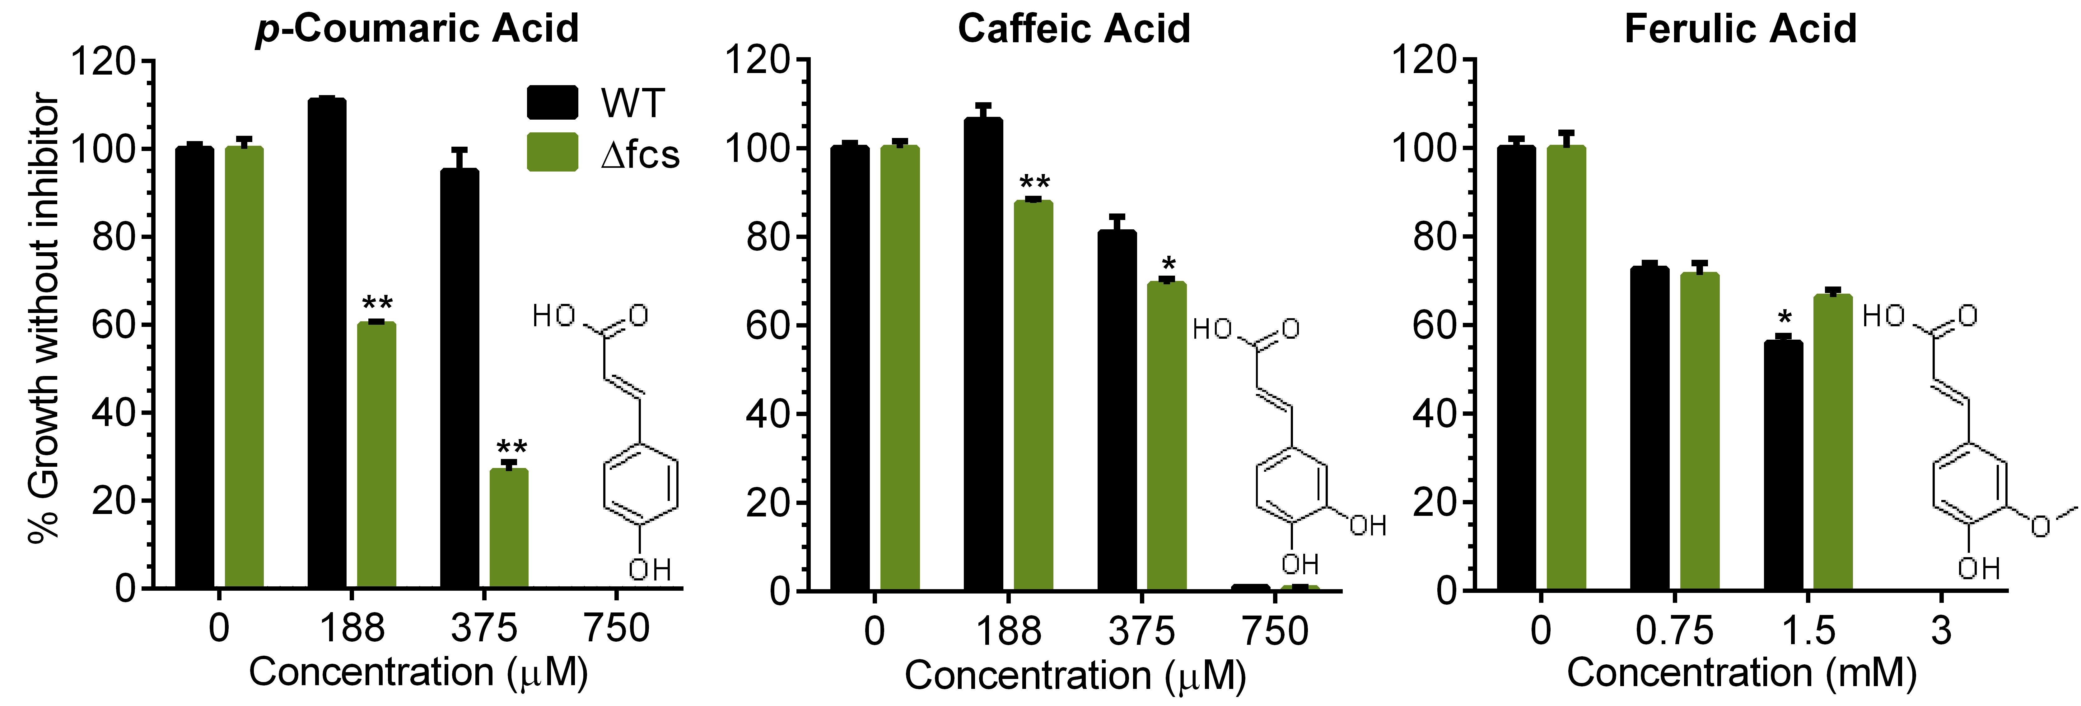
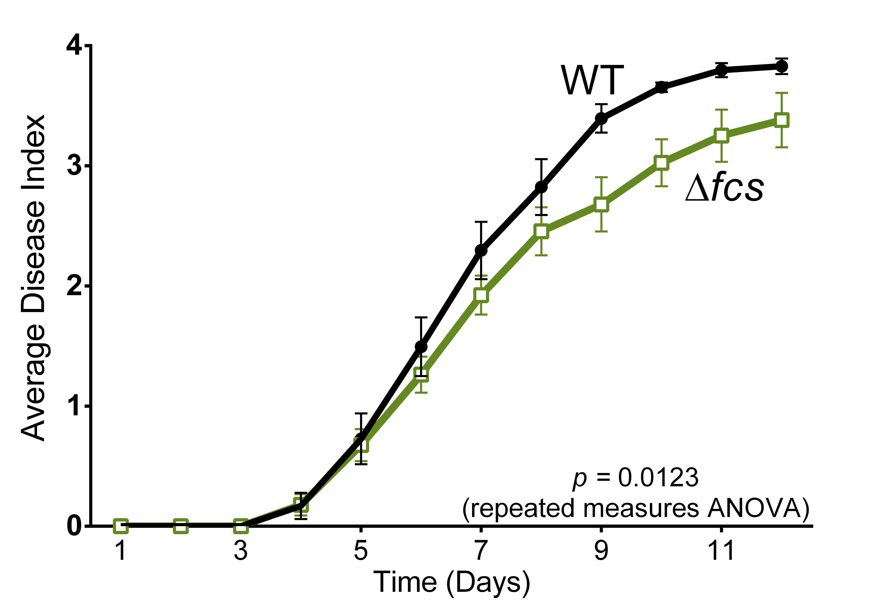
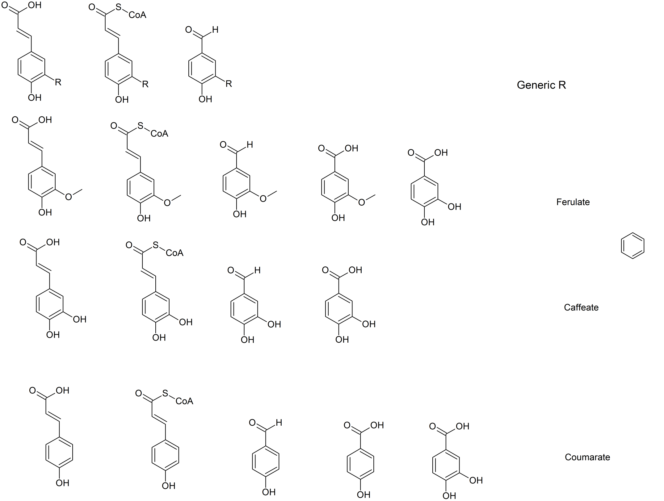
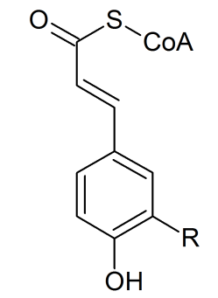
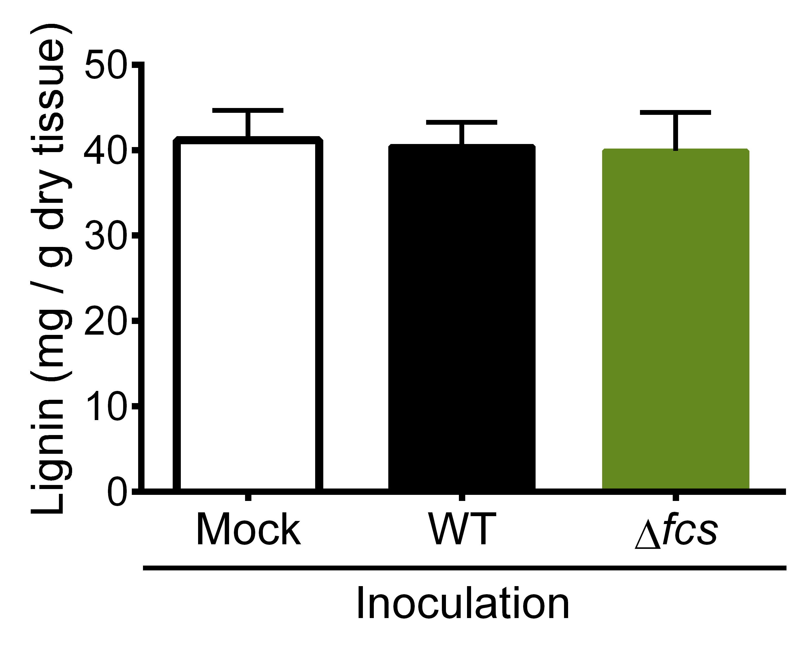
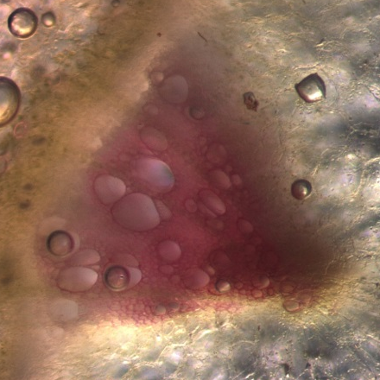
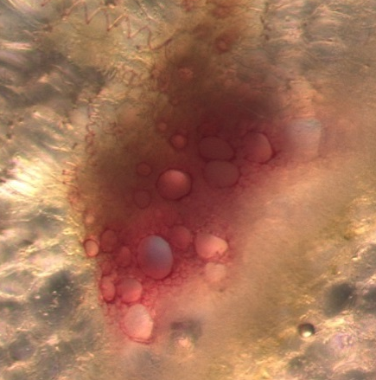
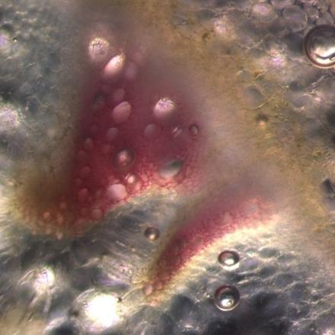

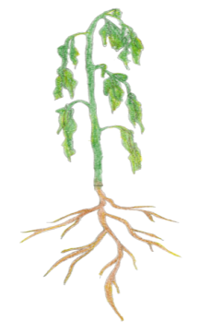
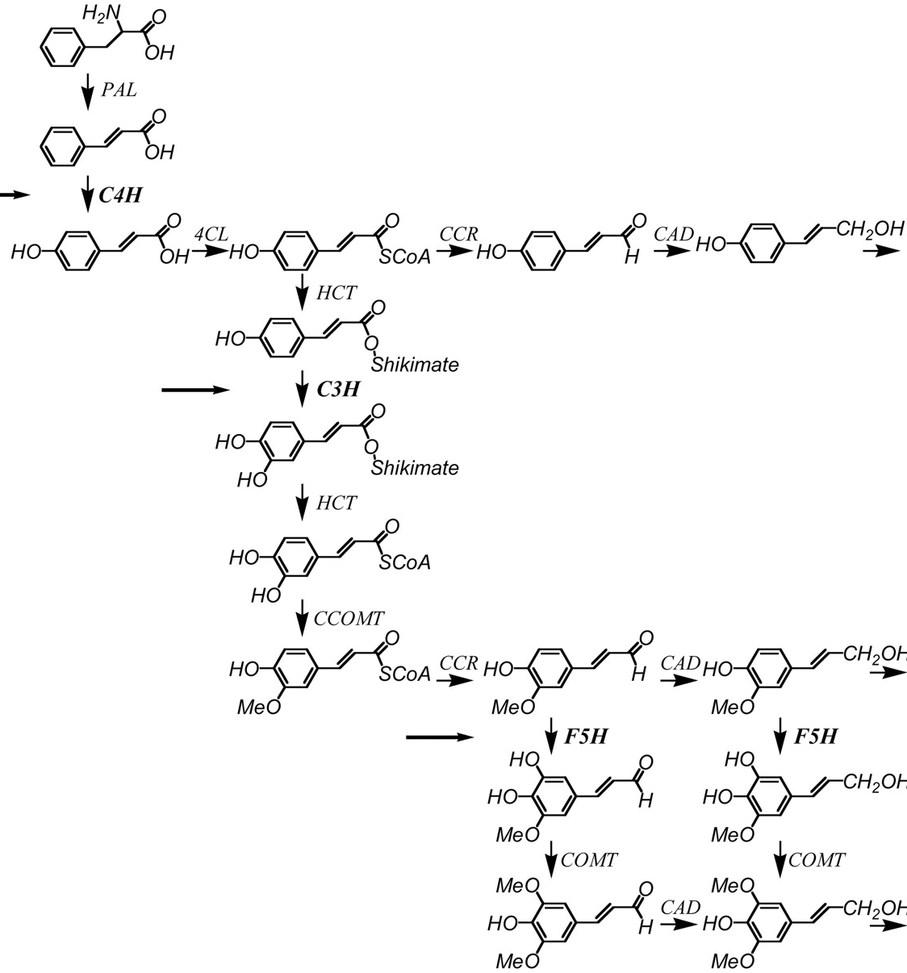
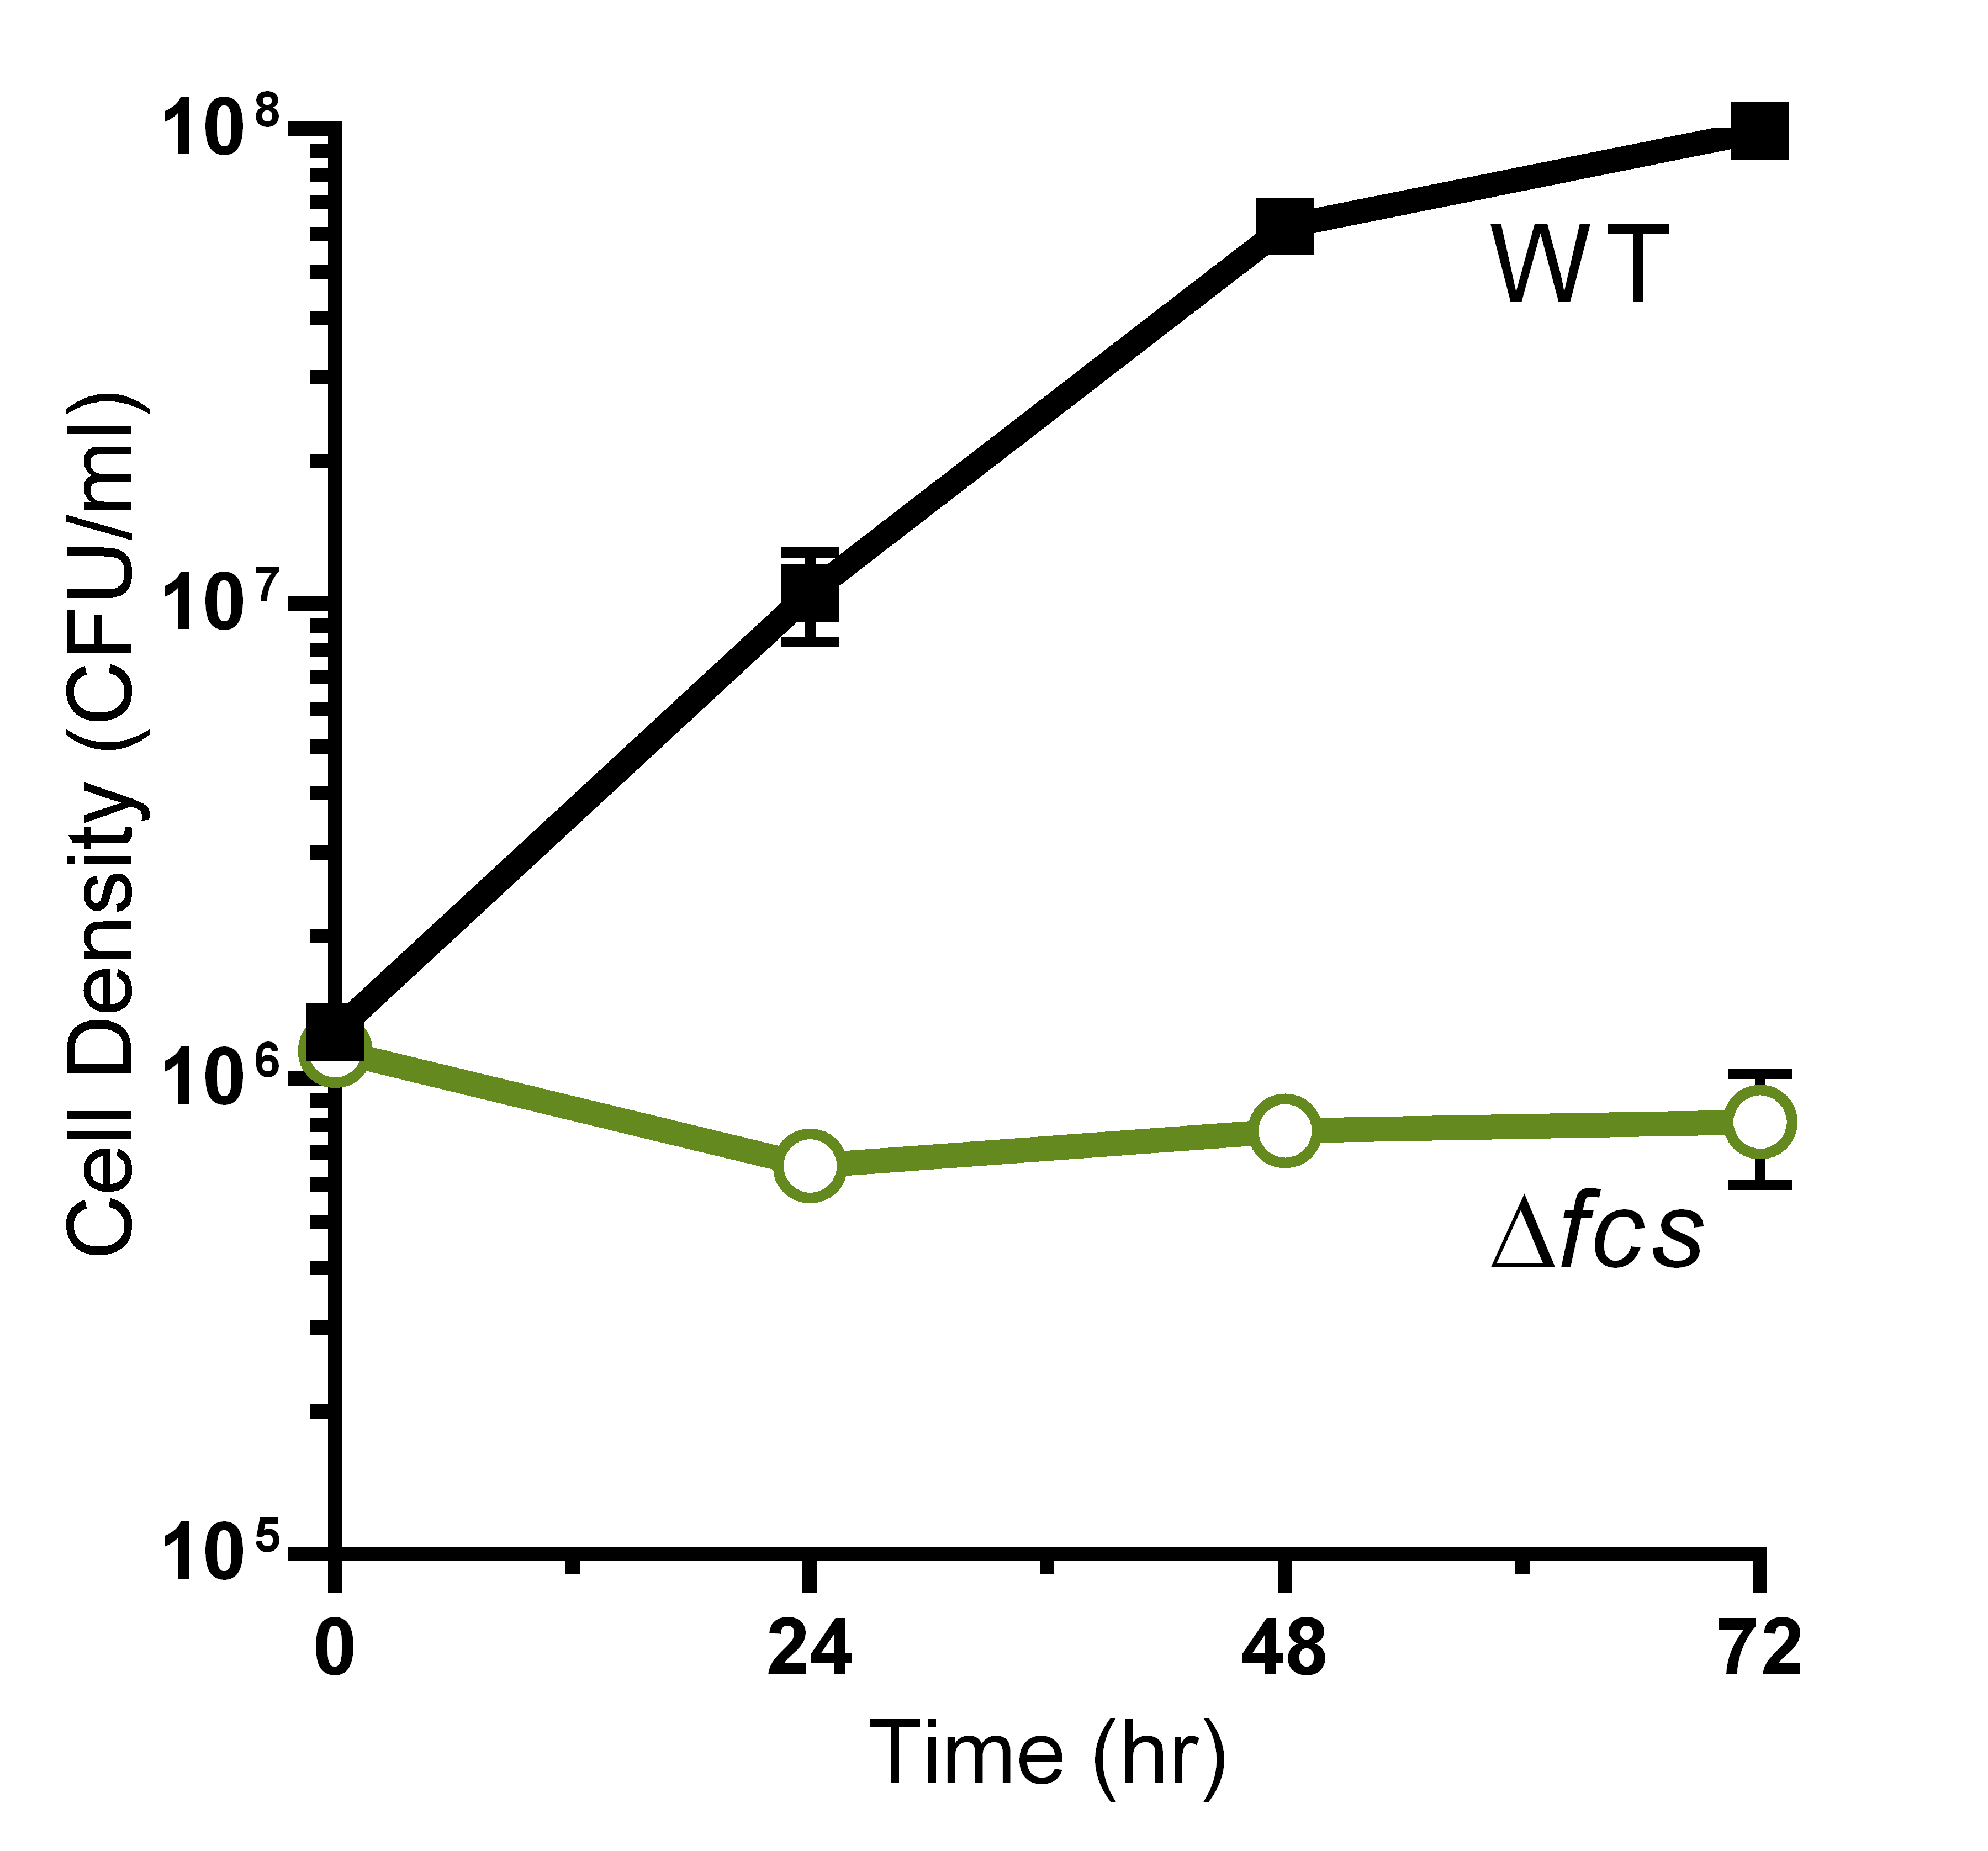
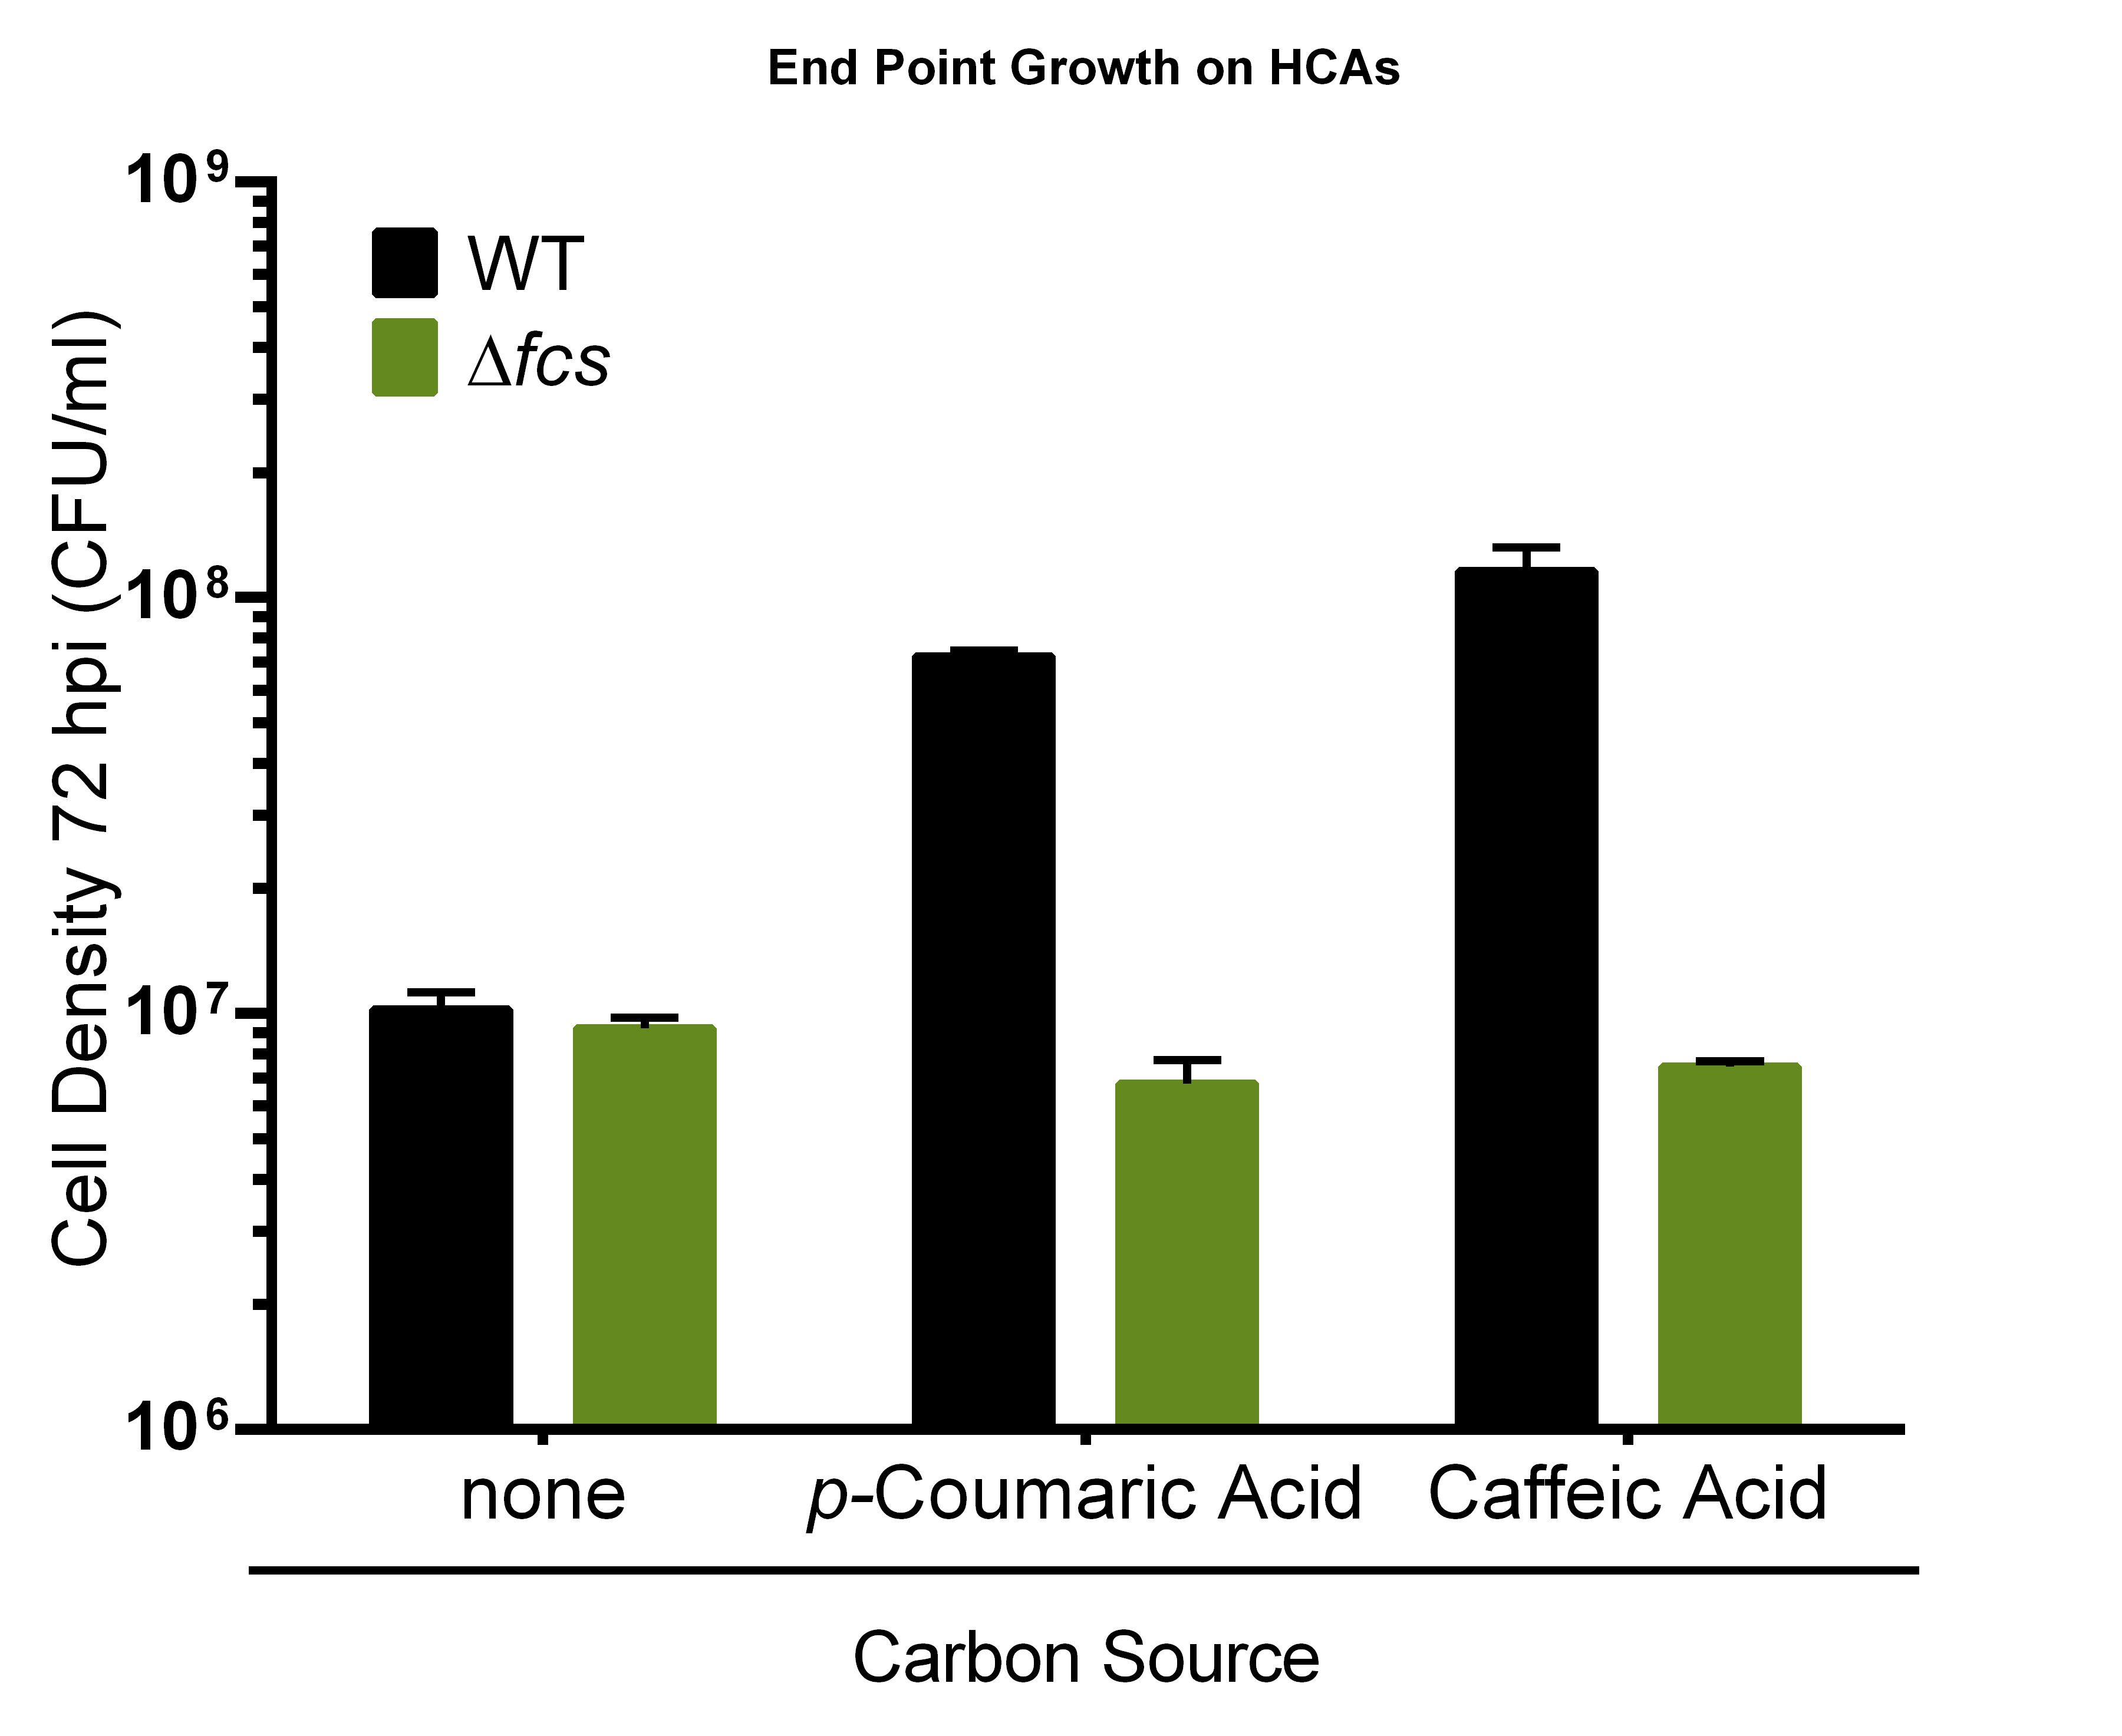

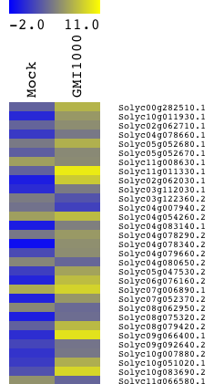

Degradation of Plant Antimicrobial Hydroxycinnamic Acids Contributes to Pathogenic Success of Ralstonia solanacearum
Tiffany Lowe¹, Raka Mitra², Annett Milling¹, Melanie Mustful¹, & Caitilyn Allen¹
¹Microbiology Doctoral Training Program & Department of Plant Pathology at University of Wisconsin, Madison; ² Department of Biology, Carleton College, Northfield MN
Introduction
R. solanacearum needs HCA degradation for full virulence
on susceptible tomato plants
HCA degradation protects R. solanacearum against HCA toxicity
The xylem-colonizing plant pathogen Ralstonia solanacearum causes a fatal wilting disease, a source of major economic losses on a wide range of food crops. Plants defend themselves from pathogens by a process functionally analogous to melanization in insect immunity¹; plants produce phenylpropanoids, which function as antimicrobial compounds and precursors of a recalcitrant physical barrier, lignin². During disease, R. solanacearum expresses genes encoding enzymes that degrade a class of plant phenylpropanoids, hydroxycinnamic acids (HCAs)³.
Fig 3: Virulence Assay:
Naturalistic inoculation: bacteria poured into soil of unwounded, individually potted plants
Symptoms rated on 0-4 scale:
0: asymptomatic
1: < 25% wilted
2: < 50% wilted
3: < 75% wilted
4: < 100% wilted
N = 82 plants per strain
To test the hypothesis that HCA degradation is important during bacterial wilt pathogenesis, we constructed a mutant with a cleanly deleted fcs gene, which encodes the first enzyme in the HCA degradation pathway.
R. solanacearum Hydroxycinnamic Acid (HCA) Degradation Pathway
Fig 5: An R. solanacearum mutant that cannot degrade HCAs was more inhibited than its wild-type parent by the HCAs p-coumaric acid and caffeic acid. Strains were grown in minimal media with 10 mM succinate as carbon source and HCAs at the indicated concentrations. * Indicates p<0.05 and ** Indicates p<0.005.
Δfcs
R=OCH₃
VanA/VanB
HCA degradation does not visibly reduce total host lignin
Fcs
Vanillic Acid
β-ketoadipate
pathway
Succinyl-CoA, Acetyl-CoA, Co₂
Fca
R=OH
Vdh
How does HCA degradation contribute to virulence?
H₀1: Carbon assimilation in a nutrient poor environment
H₀2: Elimination of antimicrobial molecules
H₀3: Reduction of physical barriers to systemic spread by removing lignin precursors
Hydroxycinnamic Acids
HCA-CoA
Phenolic
Aldehyde
R=H
Protocatechuic
Acid
R=OCH₃ Ferulic Acid
R=OH Caffeic Acid
R=H p-Coumaric Acid
PobA
p-Hydroxy-
benzoic acid
RNAseq analysis reveals that R. solanacearum infections induce expression of plant phenylpropanoid biosynthesis genes
Mock
WT
Δfcs
HCA degradation provides a route for carbon assimilation
Inoculation
Fig 6A: Six days post-inoculation, total lignin content (quantified by an acetyl bromide assay⁵) was similar in tomato stems inoculated with water, wild-type R. solanacearum, or the ∆fcs mutant.
Fig 6B: Tomato stem vascular bundles stained with lignin-specific phloroglucinol did not reveal obvious differences in lignin content of xylem vessels in mock inoculated tomato plant or in plants inoculated with wild-type or ∆fcs R. solanacearum.
Plant Phenylpropanoid Biosynthesis Pathway
Healthy
Tomato
R. solanacearum-
Infected Tomato
Conclusions
RNA extracted from tomato stems
HCA degradation contributes to R. solanacearum virulence.
The in planta role of HCA degradation could be carbon assimilation or toxin elimination, but is apparently not lignin removal.
Fold Expression
Phenylalanine ammonia-lyase (PAL)
HCA transferase (HCT)
Future Directions
HCA/benzoyltransferase
HCA-CoA shikimate/quinate HCA transferase
Cinnamyl alcohol dehydrogenase
We observed that a quantitatively wilt-resistant tomato line (Hawaii 7996) highly expresses phenylpropanoid biosynthesis genes during R. solanacearum infection. We will investigate the role of pathogen HCA degradation in this interaction.
Cytochrome P450 Superfamily
Fig 4A: HCA degradation allows R. solanacearum to use ferulic acid as a sole carbon source.
Fig 4B: HCA degradation allows growth on 110 µM p-coumaric acid and caffeic as sole carbon sources.
Acknowledgements
References
Contact Information
TML was supported by NIH National Research Service Award T32 GM07215
1. Kanost MR et al. 2004. Immunol Rev. 198: 97-105.
2. Dixon R. 2001. Nature 411: 843-847.
3. Jacobs JM et al. 2012. mBio 3(4): e00114-12.
4. Reddy MS et al. 2005. PNAS 102 (62): 16573-16578.
5. Dence CW. 1992. Methods in Lignin Chemistry. 33-31.
Contact Tiffany with any questions or comments at Tiff.Lowe@gmail.com
Figure adapted from Reddy et al. 2005⁴
Notes:
Font sizes
Title: 85
Authors: 56
Sub heading 36
Body text: 24
Captions: 18
2-3 colors max?
http://www.colorschemer.com/online.html

